Slide 1
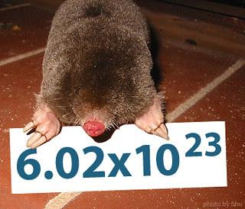
Measuring with the Mole
Share one copy of this with your group.
Make your own copy at the end of the lesson.

Slide 2
RECALL
In your group, answer the following:
- What is atomic mass?
- How many atoms of each element are in MgCl₂? How about Mg₃(PO₄)₂?
- How can you calculate the mass of MgCl₂ in atomic mass units?
If you are unsure of how to answer these, seek teacher assistance before continuing!

Slide 3
ESSENTIAL QUESTIONS
Remember, you should be able to thoroughly answer these AFTER learning through following resources.
Why is the mole a fundamental unit in chemistry, and how does it help us "count" atoms and molecules?
How can we use the mole to compare masses of different substances, even if their particles have vastly different sizes?
What are similarities and differences to other units of measurement (eg. Dozens)?

Slide 4
Instructions
Follow through the Engage to Apply resources in order .
Once confident, attempt Taking it Further work if available. This is Level 4 for course.
Record your learning in these slides. Remember to keep track of where to find these slides for studying!
Submit work from the Apply Section, IF INDICATED. Otherwise, it is regular practice work.
Try the Extend section as desired to deepen your understanding

Slide 5
Links To sections
Click for quick access to:
Engage
Explore
Apply
Extend

Slide 6
Terminology - As you encounter terms new to you, define in your own words here, include examples

Slide 7
Part 1: ENGAGE (10 minutes)

Slide 8
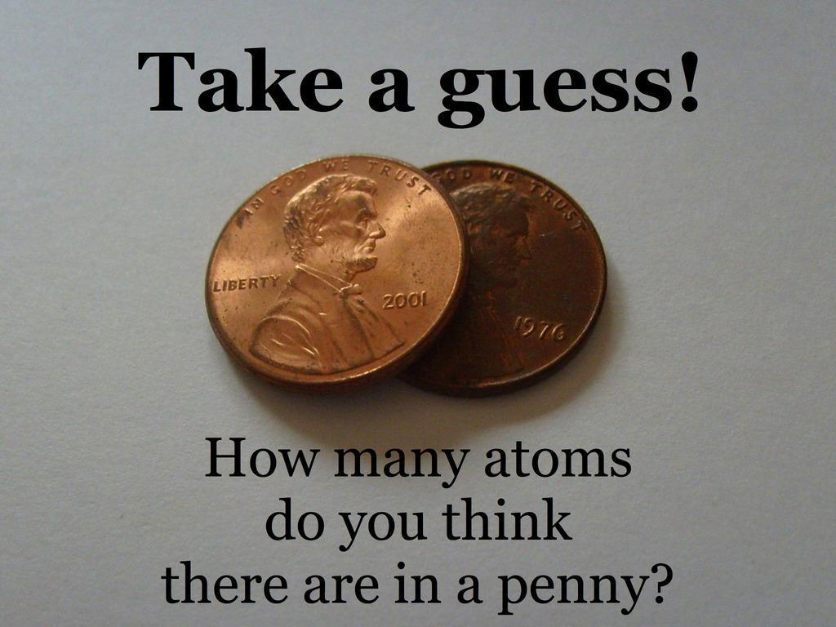
Engage: Discuss
(1 min)
Write down your own guess before comparing with your group. How different are your guesses? What would be a good way to count atoms in a useful quantity?

Slide 9
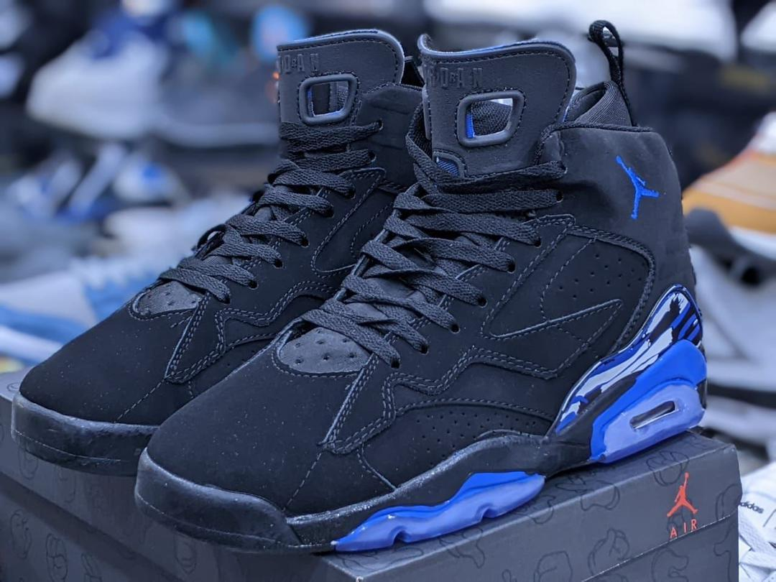
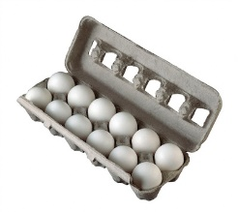
Engage: Counting things in Groups (1 min)
How would you count the following (besides just the total number)?
Shoes
Eggs/Doughnuts
Years (think of several terms for different numbers of groups)
Why do we use units like these instead of counting each item individually?

Slide 10

Engage: If you have 48 eggs how many dozens do you have? (5 min)
Work at a class whiteboard & LEAVING all work on the board as you go :
Set up an EQUATION to get from particles to amount in DOZENS and solve it using these variables:
p = Number of eggs you have (particles of egg)
N_{D} = number in 1 dozen
n = the number of dozens you have
Using your equation:
- Solve for the number of dozens in 103 pens.
- Solve for how many pens are in 6.2 dozen.
LEAVE your work on the board and/or insert an image of your work on the next slide
Discuss: Why don’t we use “pair”, or “dozen” to count groups of atoms?
Amount in Particles
Convert
Amount in chosen unit (eg dozens or moles)

Slide 11
Engage: Solving for dozens
Insert image of your group board work

Slide 12
Part 2: EXPLORE (30-40 minutes)

Slide 13
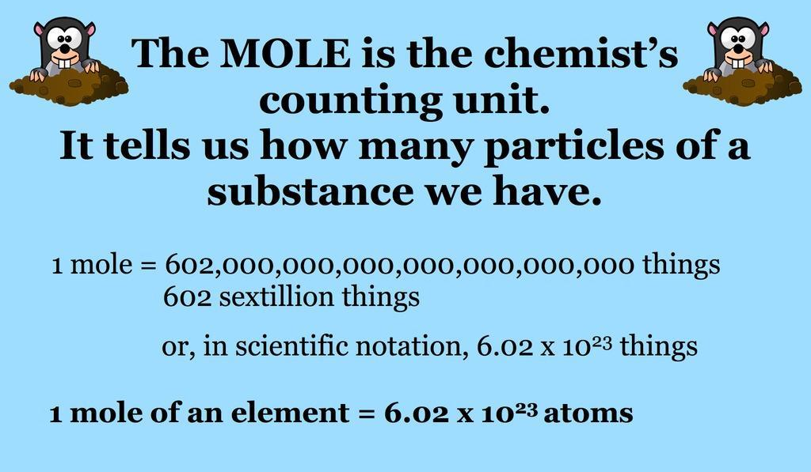
Explore: The Mole

Slide 14
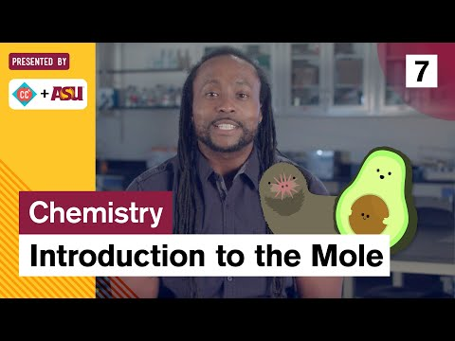
Explore: Watch {should play the 30 s -5mins mark only}

Slide 15
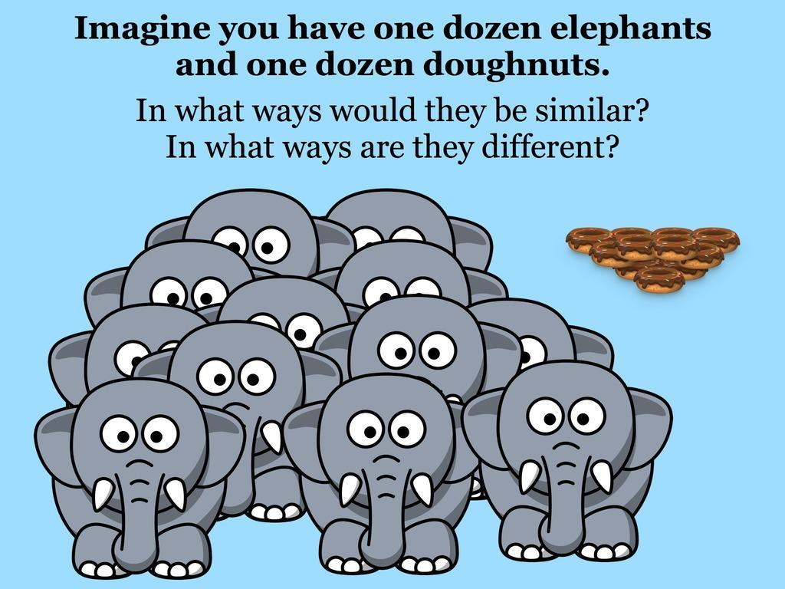
Explore: Elephants and Doughnuts
Discuss and record a few ideas here:

Slide 16
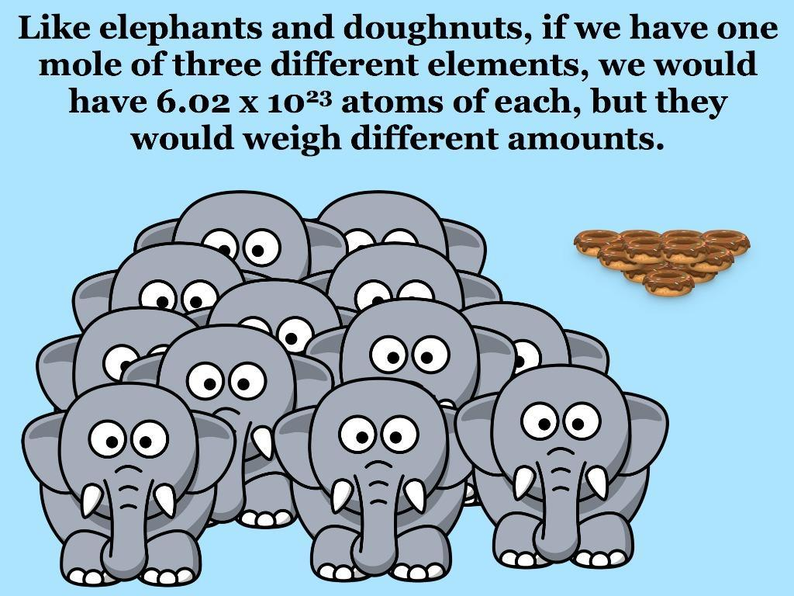
Explore: The mole helps count Particles
WHAT DO WE MEAN BY PARTICLES?
Particles in chemistry are any of the following: atoms, molecules or the formula units of ionic compounds
Substance | Particles are called
Monoatomic elements i.e. copper (Cu) | atoms
Diatomic elements (i.e. O₂) or molecular compounds (i.e. H₂O) | molecules
Ionic compounds (i.e. NaCl) | formula units

Slide 17
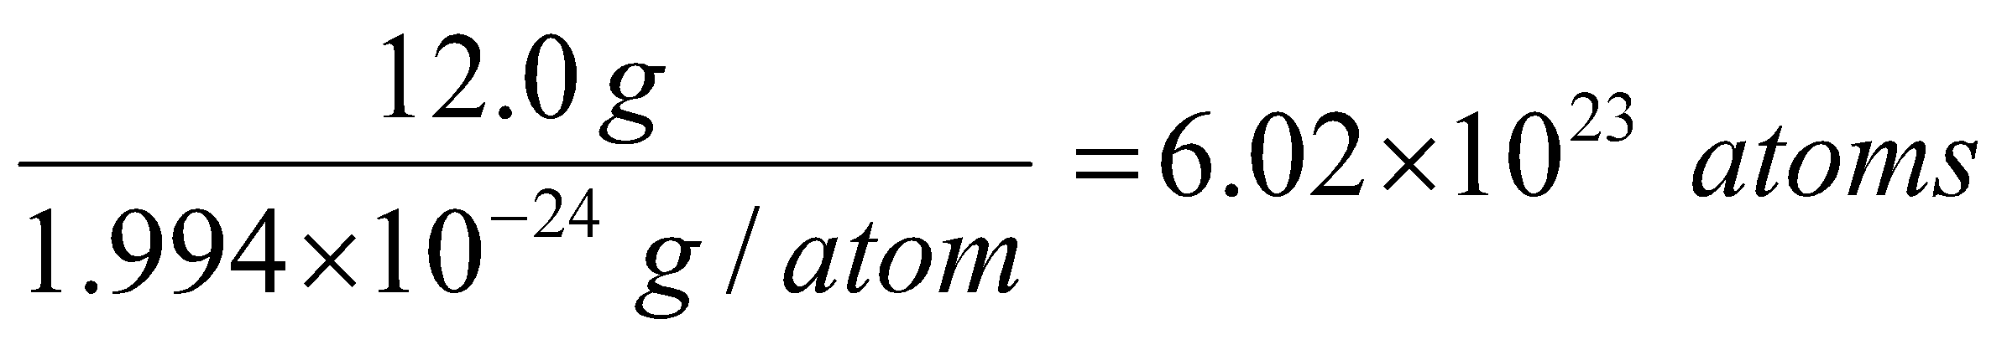
Explore: Defining the mole
The mole was based on the number of atoms in 12 grams of the isotope carbon-12:
1 mole =
This number, 6.02 x 10²³ is known as Avogadro’s Constant, or Avogadro’s Number (N_{A}).
Note that it’s units is really just “particles/mol”, in other words whatever you happen to be counting in.

Slide 18
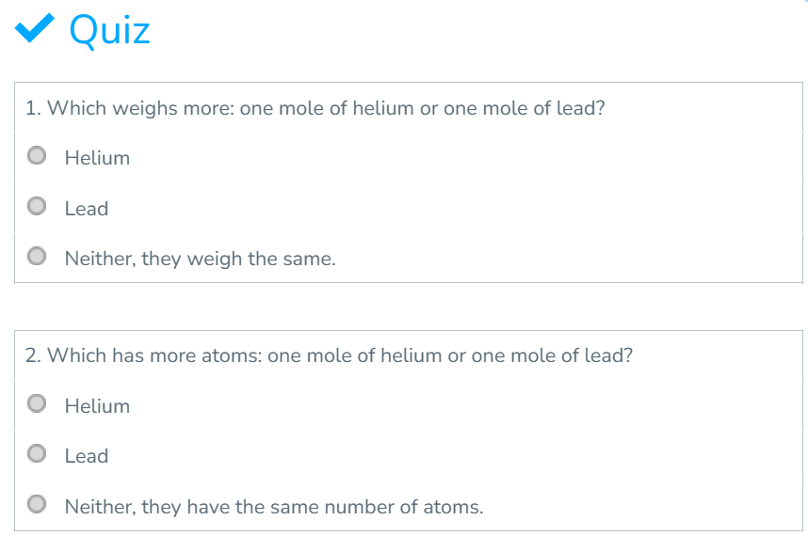
Explore: Discuss and Check with your Instructor

Slide 19
Explore: Explain in your words
As a group, explain the concept of the mole in your own words using your OWN analogy and examples (ie not elephants/doughnuts).
Be sure to include: Unit, Avogadro's number, example values for elements, what the number is and why it is this number (eg why isn't a mole just 1 million or some other "simpler" number). You can write or draw!
Your Explanation:

Slide 20
Explore: Compare to how you calculated dozens
Up at your Whiteboard, compare your dozens work with calculating moles, by solving the following:
If you have 6.02 × 10²³ eggs, how many dozens do you have? How does this help you understand why we use the mole unit and not something like dozens to count atoms?
Set up an EQUATION to get from particles to amount in MOLES and solve it using:
N = Number of particles you have
N_{A} = number in 1 mole (this is Avogadro’s number)
n = the number of moles you have
Amount in Particles
Convert
Amount in chosen unit (eg dozens or moles)

Slide 21
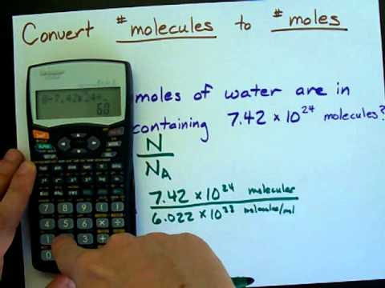
Explore: Optional Scientific Notation in Calculator
For help entering into your calculator properly you can watch this:

Slide 22
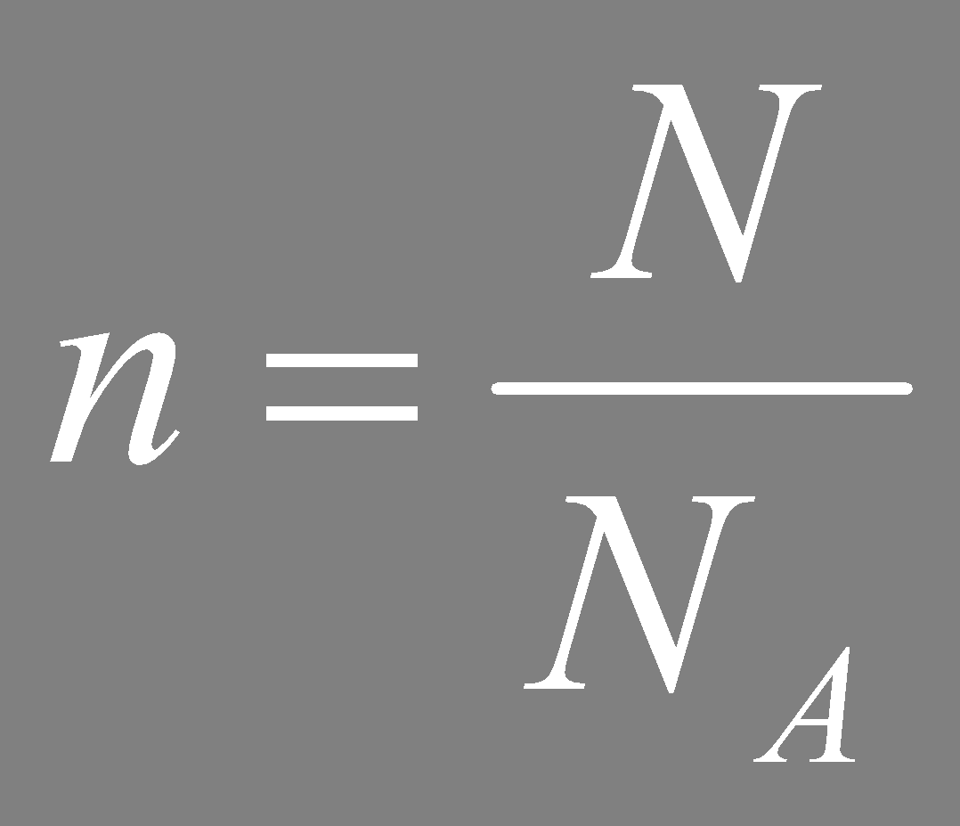
Explore: Try these problems
1. If you have 1.81x10²⁴ eggs how many moles do you have?
2. Would your answer change if it was 1.81x10²⁴ particles of sodium (Na)?
3. How about if it was 1.81x10²⁴ particles of CO2?
4. Solve this: If you have 1.204 × 10²⁴ atoms of carbon, how many moles do you have?
Answers: Move box to check!
1. 3.00 mol. 2. No, the same number of particles with equal the same number of moles regardless of substance. 3. Same, also 3.00 mol
4. n = N / Nₐ
n = 1.204 × 10²⁴ atoms/ 6.02 × 10²³ atoms/mol = 2 mol

Slide 23
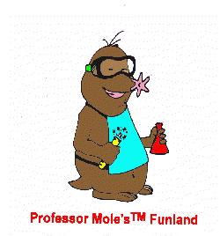
Explore: Bad mole jokes! Enjoy!
Q: How did Avogadro write to his friends?
A: By e-mole!
Q: Why was Avogadro so rich?
A: He's a multi-mole-ionare!
Q: What does Avogadro put in his hot chocolate?
A: Marsh-mole-ows!
Q: Why did Avogadro like Cindy Crawford?
A: She's his favorite super-mole-dle (and she has a mole).
Q: What did the generous Avogadro say when his friends crashed his party?
A: The mole the merrier!

Slide 24
Explore: Continue with Practice OR rest of Explore
If you are feeling comfortable with the content and are ready to move on to the next equation involving mass and the mole, continue below.
If you feel more practice on the particles and mole problems would be better before moving on then attempt Apply Slides # 1 & 2 and check in with your instructor before moving on.

Slide 25
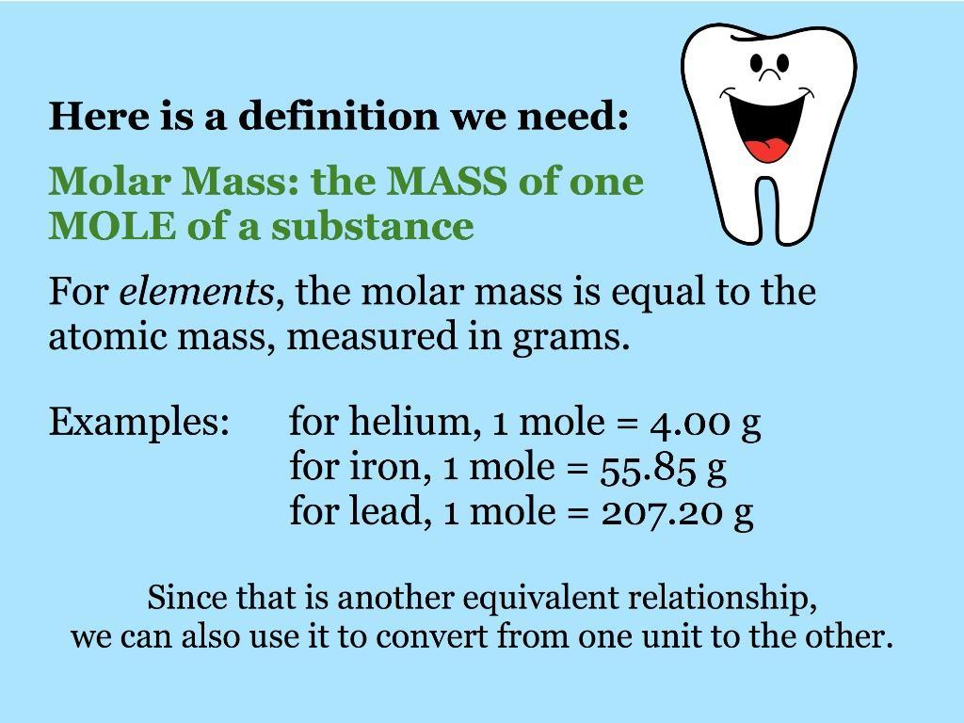
Explore: The Mole and Molar Mass
Where the mole gets properly useful! Instead of saying “The amount of helium I have is the molar mass but in grams instead of amu” (that’s a mouthful!), we can just say we have “1 mole” and all chemists and chemistry students know that means the same!

Slide 26
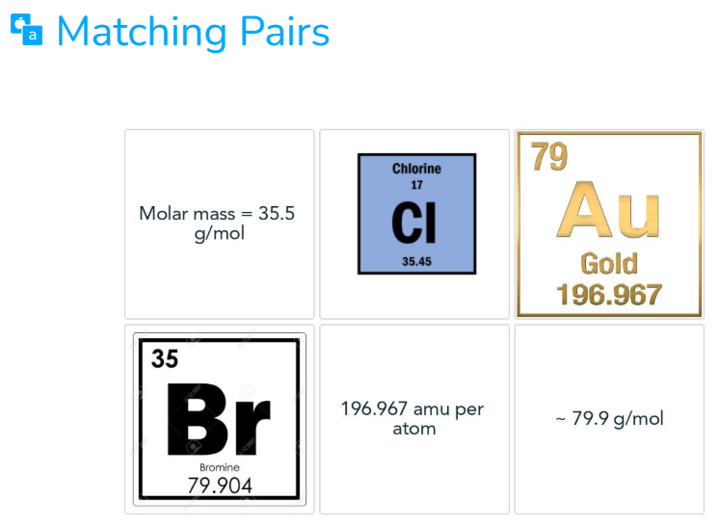
Explore: Match these elements to their masses
After matching, Try this!
If a sample has 2 moles of Cl and 3 moles of Br, what would the total mass of the sample be?
Move box for Answers:
Br = 79.9g/mol (and ALSO 79.9amu) ; Cl = 35.5g/mol (and ALSO 35.5amu), Au = 196.967 amu (and ALSO 196.967amu).
Hope you didn’t get tripped up and confuse the gold’s atomic number of 79 with its atomic mass .
For the TRY THIS: = 2 (35.5g/mol) + 3(79.9g/mol) = 310.7g/mol

Slide 27
Explore: Calculating From Mass
Make sure you have the equation for particles to moles on the top arrow
Amount in Particles
Amount in chosen unit (eg dozens or moles)
Amount in MASS

Slide 28
Explore: Converting to Molar Mass
If you have 60 g of eggs how many dozens do you have? (1 dozen eggs = 30 g)
Set up an EQUATION to get from amount in mass to amount in DOZENS and solve it using:
m = mass of eggs you have
MM = mass of 1 dozen eggs
n = the number of dozens you have
Using your equation:
If you have 3.2 dozen eggs how many grams do you have? (1 dozen eggs = 30g)
If you have 3.2 dozen eggs how many EGGS (aka “particles”) do you have? Which conversion arrow of the diagram are you on (from slide above)?
For your 3.2 dozen eggs converted to mass of eggs or number of eggs, what is true about the actual quantity of eggs?

Slide 29
Explore: Converting to Molar Mass
The relationship between moles, Molar Mass and mass of a compound is:
Where: n = number of moles.
m = mass of sample
MM = molar mass of the substance
Relate this to your Eggs equation!
In your group: Show the steps to rearrange this equation for each variable: {m = ? and MM = ??}
NOTES: you do NOT have to show the details of rearranging on assessments. You can rearrange before or after putting in numbers although BEFORE IS RECOMMENDED
m
n = MM

Slide 30
Explore: Converting single elements to Molar Mass
At the white board solve the following and insert images of your work:
1. How many moles are in 74.26g of Na?
2. How many grams are in 0.383 moles of C?
3. What is the molar mass of H₂O if there are 36.04g in 2 moles (show the work using the formula even if you can do it in your head!)?
ANSWERS (move the box): Check in with your instructor!
1. 3.23mol; 2. 4.6g 3. Showing your work: MM= m/n = 36.04g/2mol = 18.02g/mol

Slide 31
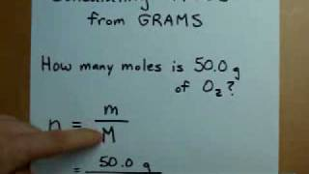
Explore: {Optional} One problem solved
For help you can watch this problem walk through (1.5min):

Slide 32
Explore: Molar Mass of Compounds
We need to be able to calculate the molar mass of compounds to determine the moles of a compound. We apply the Law of Definite Proportions in order to do this:
Law of Definite Proportions
A specific compound always contains the same elements in definite proportions by mass.
In other words: Molecules of the same of compound will always have the same subscripts.
Example: All Carbon Dioxide molecules have the formula CO2 and will therefore be composed of one carbon atom and two oxygen atoms.

Slide 33
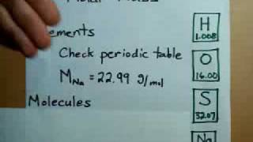
Explore: How to calculate Molar mass from the Periodic table
You can follow the steps below and/or watch the 3min video to learn to calculate molar mass with CO₂:
Determine which atoms are present and how many of each there are.
Substitute the atomic weight from your periodic table in for each atom.
Perform any required multiplication and add all of the molar masses up
Element | Molar mass of Element | Number in Compound | Total mass in compound
C | 12.01g/mol | 1 | 12.01 g
O | 16.00g/mol | 2 | 32.00 g
Total for compound |  | 3 atoms total (or 3 moles of atoms in 1 mole of CO₂) | 44.01g/mol Molar mass of CO₂

Slide 34
Explore: Try!
What is the Molar Mass of KHSO4?
You can use the table while getting used to how to calculate. In your homework and on assessments, you can calculate as in the answer, simply creating an equation.
Element | Molar mass of Element | Number in Compound | Total mass in compound
Total for compound
Answer: Move box to reveal
MM_{KHSO4} = 1(39.10) + 1(1.01) + 1 (32.06) + 4(16.00) = 136.17g/mol
ASK for help if you weren’t able to get this answer and/or don’t understand this answer!

Slide 35
Explore: Use molar masses with moles
On a white board, try the following:
1. If you have 24.02 g of carbon dioxide (CO₂), how many moles do you have?
2. If you have twice as much as the above question, so 1.092 moles of carbon dioxide, what would you expect the mass to be? Rearrange the equation to prove it!
Answer, move box to check!
1. n = m / MM
n = 24.02g / 44.01g/mol = 0.5456 moles ** Always include the units IN the calculation. Cancel out units and you should be left with the correct units for the answer. If not, it indicates a problem with your set up that needs to be corrected!
2. m = n × MM
m = 1.092 mol× 44.01g/mol= 48.04 g (twice as much mass when you double the moles of the same substance!

Slide 36
Part 3: Apply
(20-40 minutes; includes home practice time)

Slide 37
Apply #1: Importance of the mole
Explain why the mole concept is important in chemistry.
How does it help us measure substances in the lab?
Why do we need to know how many particles are in a sample?

Slide 38
Apply #2: Mole and Particle practice
Try these independently before comparing with your group. Try to agree on an answer and understand it before double checking your work with the answers.
1. What is Avogadro's number?
i. 6.02 × 10²⁴
ii. 6.02 × 10²²
iii. 6.02 × 10²³
iv. 6.02 × 10²¹
2. How many atoms are in 2 moles of helium (He)? {Hint: would the answer be the same or different for a different element?}
i. 6.02 × 10²³
ii. 1.204 × 10²⁴
iii. 1.204 × 10²²
iv. 6.02 × 10²¹
3. Convert the following:
a. How many moles are in 3.01 × 10²³ atoms of carbon?
b. How many atoms are in 2.5 moles of oxygen?
ANSWERS: 1.. iii, 2. Ii 3. a. 0.5 moles b. 1.505 × 10²⁴ atoms

Slide 39
Apply #3 : Mole and Mass Practice
1. What is the mass of 2 moles of carbon dioxide (CO₂)?
i. 44 g
ii. 88 g
iii. 22 g
iv. 66 g
2. How many moles are in 36 grams of water (H₂O)?
i. 1 mole
ii. 2 moles
iii. 3 moles
iv. 4 moles
3.Convert the following:
a. How many moles are in 50 grams of water (H₂O)?
b. What is the mass of 0.5 moles of carbon dioxide (CO₂)?
ANSWERS: 1. ii. 2. Ii 3. a. 2.78 moles b. 22 g

Slide 40
Apply #5: Combining mass and particle calculations
In your groups on the whiteboard, let’s solve our penny problem! If a penny is made of 3.11 grams of copper, how many atoms of copper are in the penny?
Show your calculations and answer with units. You will need to use both equations, to solve FIRST for the moles of copper, then use the moles to solve for particles. HINT: where are you starting and where are you ending up on the diagram below?
It is crucial in this unit to get in the habit of listing your given values and your required value WITH UNITS before solving and entering the numbers WITH units into each calculation. Try to remember to use significant figures!
Add an image of your work to these slides.
Amount in Particles
Amount in chosen unit (moles)
Amount in MASS

Slide 41
Apply #6: The mole hole game
Play by asking for a Class Set sheet (return it!) or opening this link.

Slide 42
Apply #5: Practice Work
Complete the practice work as indicated in the unit plan and/or sheets given in class.
Its important in this unit to do plenty of practice to be confident of each topic before moving to the next one! It is also good practice to save some practice work, once you are confident, to complete over the next several days & weeks from the lesson.
Spaced practice solidifies your understanding and long term retention!

Slide 43
Part 4: Beyond the course extensions & Extra help {optional}

Slide 44
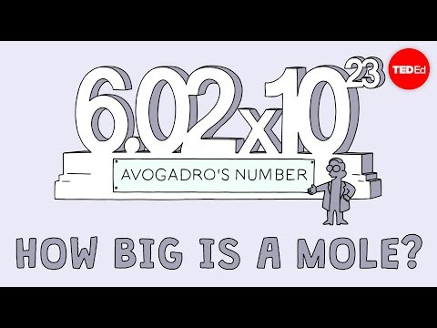
Extra help: Visualizing the mole
This is a great video to help grasp just how large the number in mole is, and therefore how very very small atoms are.

Slide 45
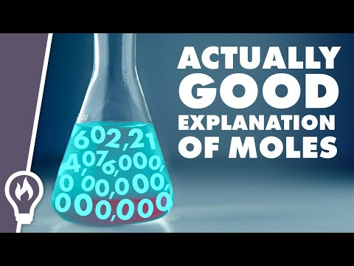
Extra help: Understanding the mole concept
Another explanation of the mole and why we use it for further help in understanding this concept

Slide 46
